Slide 1
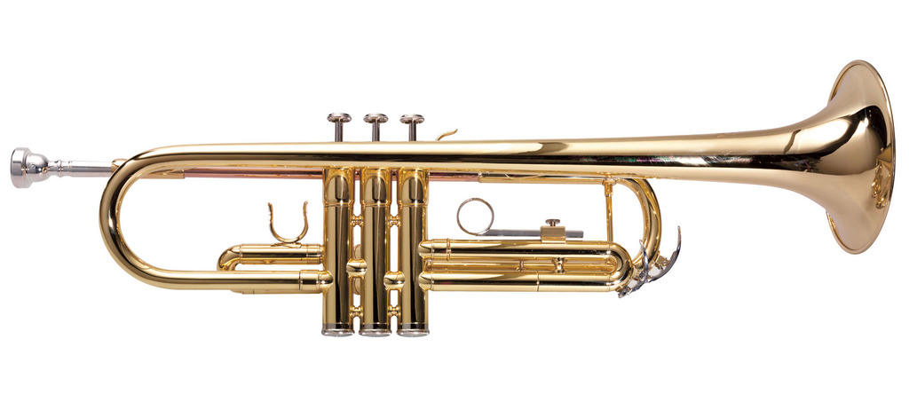
MUSICAL INSTRUMENT IDENTIFICATION USING MACHINE LEARNING

Slide 2

Musical instrument identification plays an important role in musical signal indexing and database retrieval
People can search music by musical instruments instead of type or author.
By using this project we can detect the audio belongs to which Particular instrument

Slide 3

TABLE OF CONTENTS
Problem statement
OBJECITVE
Existing work
Proposed work
Tools(software, dataset)
Objective
Program
Outcomes
References
Conclusion

Slide 4
PROBLEM STATEMENT
This project describes about the identification of musical instruments from the data set which is having 600 sound samples of total six classes
This projects aims to build to machine learning model which aims to classify the classes and predict the musical instruments based on feature vectors of audio samples
Main objective of our project is “musical instrument recognition”using the concepts of signal processing in frequency domain and feature classification using machine learning techniques

Slide 5
OBJECIVE
Music is pervasive in our daily lives, present across all cultures and constantly evolving. One might argue that the ability to interact with music is an exclusively human quality. Streaming giants such as Spotify and Apple (just to name a few) curate their content and offer personalized recommendations for their users. To do so they possess powerful tools that classify entries based on genre, instruments, and lyrics
There is a real need for these businesses to get their predictions correct and without depleting their resources. Some sources suggest that ”Spotify adds 10,000 to 30,000 songs a day

Slide 6
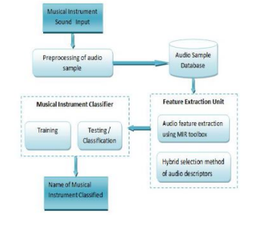
PROPOSED METHODOLOGY

Slide 7
TOOLS REQUIRED
Google colab
Audio and python Libraries
Data set

Slide 8
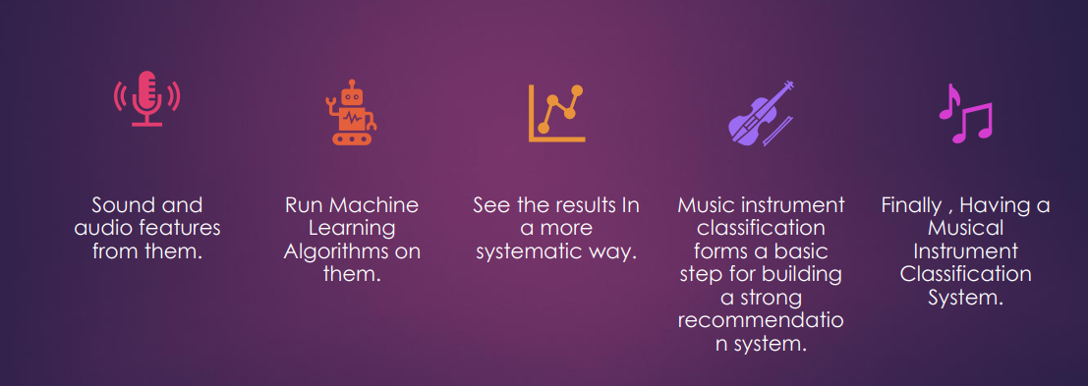
PROJECT PIPELINE

Slide 9
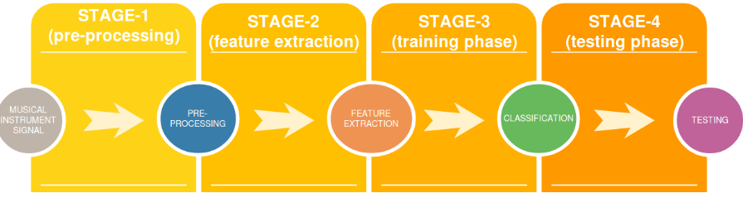

Slide 10
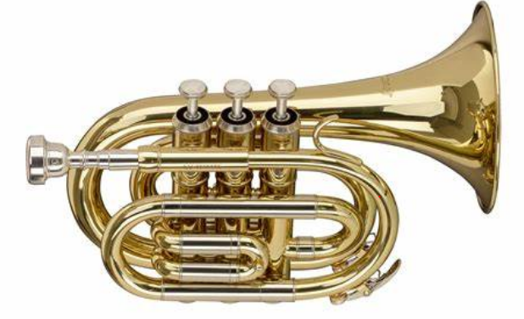
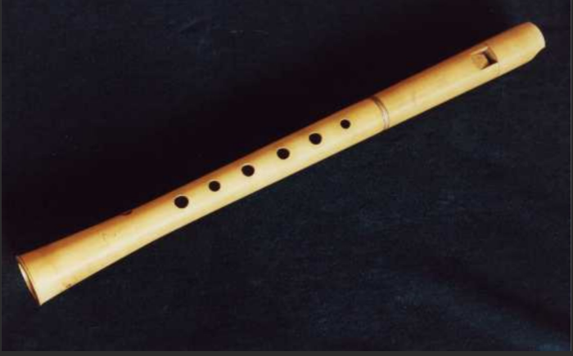
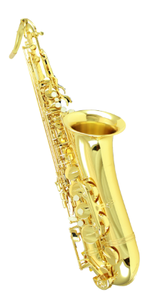
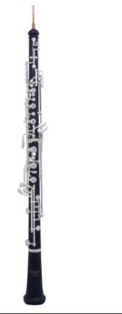
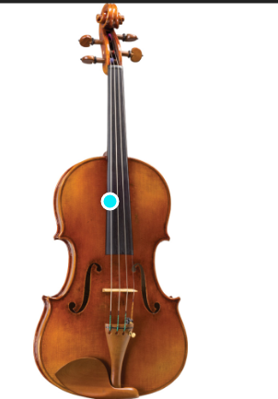
Data set
Our data set comprises of musical instruments :
Flute - 100 samples
Trumpet - 100 samples
Saxophone - 100 samples
Oboe - 100 samples
Viola - 100 samples
Cello - 100 samples
Total - 600 Samples
Link of sound samples
Sound samples | Philharmonia

Slide 11

Results
It gives us the name of the instrument when we give a audio file as input
For example
Guitar , flute …..

Slide 12
Conclusion
After analyzing different classification techniques on the given data we got highest 98% accuracy with SVM by using kernel ‘rbf’ and 94% with knn classifier
when separating musical instruments, choosing an indicative subset of features to predict on is extremely important or It may lead to wrong prediction

Slide 13


